Slide 1
BLOCKCHAIN-BASED CARBON CREDIT ECOSYSTEM
Guide:
Mrs. Parvati Bhadre
Team Members:
Amol Netke - 71
Yogesh Zade - 72
Harsh Satwani -74
Yuvrajsing Solanke -76

Slide 2
What are Carbon Credits?
Definition: A carbon credit is a permit or allowance that grants industries the right to emit a specified amount of carbon dioxide (CO2) or equivalent greenhouse gases. Typically, one carbon credit allows for the emission of one ton of CO2.
Market Mechanism:
These credits are part of a cap-and-trade system where companies that reduce their emissions can sell their excess credits to other companies that need them, creating a financial incentive to lower overall emissions.
Need:
To help reduce global greenhouse gas emissions and combat climate change.
They encourage companies to invest in cleaner technologies by making it financially beneficial to reduce emissions.

Slide 3
Current Carbon Credit Ecosystem
Lack of Transparency: Difficulty in tracking and verifying carbon credits leads to doubts about their authenticity and impact.
Fraud and Double Counting: Risk of credits being sold multiple times or fraudulent credits being issued due to insufficient oversight.
Centralization Issues: Control by a few large entities limits access and creates inefficiencies in the carbon credit market.
High Transaction Costs: Fees and complexities associated with trading carbon credits can be prohibitive for smaller projects.
Delayed Verification: Long timeframes for project verification slow down the process and reduce overall market efficiency.

Slide 4
Our Vision
Aim : We aim to revolutionize the carbon credit market by leveraging blockchain technology to create a more transparent, efficient, and inclusive system
Enhancing Transparency: Blockchain provides immutable records for every carbon credit transaction, ensuring full transparency and traceability throughout the credit lifecycle.
Eliminating Fraud: Decentralized networks and smart contracts reduce the risk of fraud and double counting, ensuring that each carbon credit is genuine and properly accounted for.
Improving Efficiency: Automated processes and real-time verification accelerate project validation and streamline market transactions, enhancing overall system efficiency.
Promoting Global Participation: Our platform enables a broader range of projects, including those from developing regions, to participate in the carbon market, fostering greater global engagement and impact.

Slide 5
System Design
Blockchain Network: Utilizes a [public/private/consortium] blockchain to ensure transparency and security.
Smart Contracts: Automates transactions and enforces rules for carbon credit issuance, trading, and retirement.
Carbon Credit Lifecycle: Manages the entire lifecycle from issuance and validation to trading and retirement, ensuring accurate tracking and avoiding double counting.
User Interfaces: Provides intuitive interfaces for issuers, traders, and auditors to interact with the system and manage their activities.
Integration and Scalability: Integrates with existing carbon credit registries and other systems via APIs, with scalable infrastructure to handle increasing transaction volumes.
Security Measures: Utilizes advanced encryption methods to protect data and transaction and implements robust authentication and authorization protocols to safeguard sensitive information.
Regulatory Compliance: Ensures compliance with international and local regulations for carbon credits and facilitates regular audits and assessments to verify compliance and maintain trust.

Slide 6
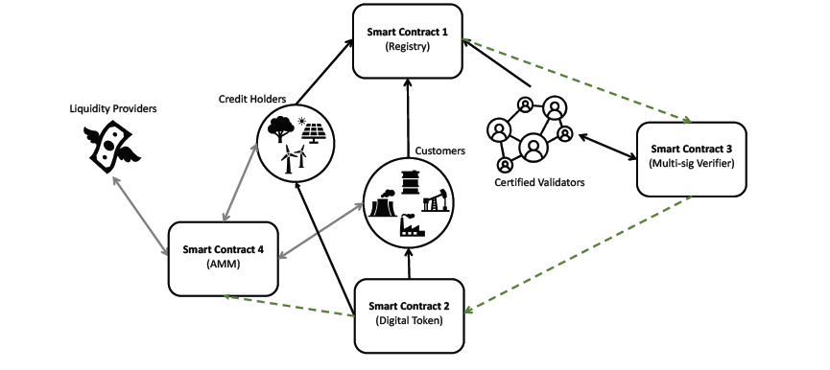
Smart Contracts Overview
Registry System Records and manages information for verifiers, credit-holders, and customers, ensuring accurate data for the carbon credit ecosystem.
Carbon Token Management Facilitates the creation, transfer, and burning of carbon tokens, and issues NFTs as proof of successful carbon offsets.
Multi-Signature Verification Allows verifiers to approve the minting and burning of tokens, requiring a minimum of 70% verifier approval for execution.
Automated Market Maker (AMM) Enables automated trading of carbon tokens with digital currencies, incentivizes liquidity providers with transaction fees, and ensures dynamic pricing in the market.

Slide 7
Lifecycle of a Carbon Credit
Issuance:
Creation: Credits are issued based on verified emission reductions.
Registration: Recorded on the blockchain for transparency.
Validation:
Certification: Credits are validated by verifiers to ensure they meet required standards.
Verification: Confirms the authenticity and accuracy of the credits.
Trading:
Market Access: Credits can be traded on the platform, leveraging automated trading mechanisms.
Price Discovery: Dynamic pricing based on market demand and supply.
Retirement:
Offsetting: Credits are retired once used, preventing reuse and ensuring accurate tracking.
Proof of Offset: Issuance of non-fungible tokens (NFTs) as proof of successful carbon offset

Slide 8
Tech Stack Overview
Blockchain Platform:
Ethereum – Provides a secure environment for deploying smart contracts and managing carbon credits
Smart Contract Development:
Solidity – Language for writing smart contracts.
Development Frameworks :
Truffle – Framework for managing and deploying smart contracts.
Front-End Integration:
web3.js – JavaScript library for interacting with the Ethereum blockchain.
Automated Market Maker (AMM):
Uniswap Protocol – Facilitates automated trading and liquidity provision for carbon tokens.
APIs:
Integration APIs – Connect with existing carbon credit registries and other systems.

Slide 9
Conclusion
Our blockchain-based carbon credit system leverages cutting-edge technology to create a transparent, efficient, and secure marketplace for carbon credits.
By utilizing Ethereum and Solidity for smart contracts, and integrating with frameworks like Truffle and tools such as web3.js, we ensure seamless functionality and user interaction.
The Automated Market Maker protocol facilitates dynamic trading and liquidity, while APIs and OpenZeppelin enhance system integration and security.
This comprehensive tech stack not only streamlines carbon credit management but also supports scalable and sustainable practices, driving forward our commitment to environmental impact and market innovation.

Slide 10
Thank You!

